Slide 1

AMAZON PRODUCT REVIEW ANALYSIS
PRESENETED BY -
SHRITESH JAGTAP
JITENDRA GIRISH PATIL
PUNEETHKRISHNA B.
SAMRADDHI SHRIVASTAVA

Slide 2
Introduction
In the retail e-commerce world of the online marketplace, where experiencing products is not feasible. Therefore, customers need to rely largely on product reviews to make up their minds for better decision-making on purchases.
However, searching and comparing text reviews can be frustrating for users. Hence we need a better numerical rating system based on the reviews which will make customers’ purchase decisions with ease.
The amazon review dataset for Musical Instrument, Digital Music, and Amazon Instant Video Category was considered. And hence based on different criteria obtained from this project we help the consumer and the marketing industry to get the best out of the review system.
COLUMNS | DESCRIPTION
ASIN | PRODUCT ID
REVIEWTEXT | REVIEWS
REVIEWERNAME | REVIEWER NAME
OVERALL | RATING
UNIXREVIEWTIME | REVIEW TIME
REVIEWTIME | REVIEW DATE
USERID | REVIEWER ID
TITLE | PRODUCT NAME
CATEGORIES | SUB CATEGORIES
PRICE | PRICE OF PRODUCT
BRAND | BRAND OF PRODUCT

Slide 3

THE OBJECTIVE OF THE PROJECT
To develop an automated system to analyze and monitor an enormous number of reviews.
To Increase the success rate of existing and new products and market campaigns.

Slide 4
TABLE OF CONTENT
PREPROCESSING AND CLEANING
EXPLORATORY DATA ANALYSIS
SENTIMENT ANALYSIS
TEXT CLASSIFICATION
TIME SERIES ANALYSIS
CLUSTERING
PRODUCT RECOMMENDATION
CUSTOMER SEGMENTATION
SUMMARY TABLE
BUSINESS SOLUTIONS

Slide 5




PREPROCESSING AND CLEANING
Data Importation
Missing Value Treatment
Feature Scaling
Data Exploration
Feature Selection
1
3
5
2
4

Slide 6
EXPLORATORY DATA ANALYSIS
UNIVARIATE ANALYSIS
MULTIVARIATE ANALYSIS
BIVARIATE ANALYSIS

Slide 7
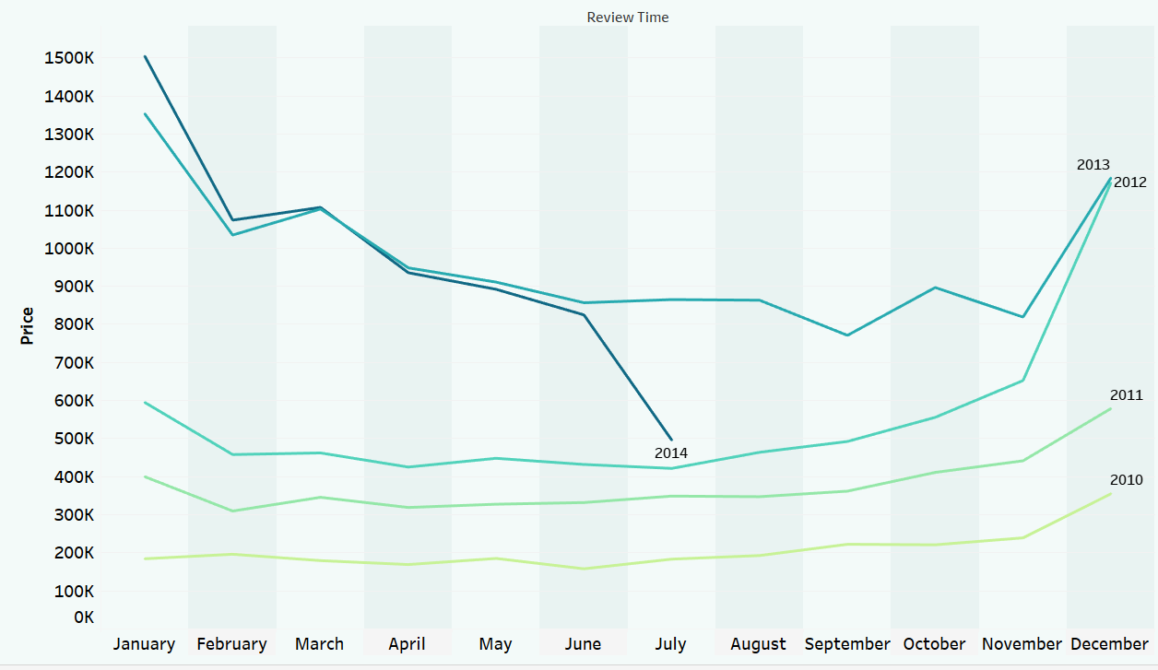
MONTH WISE REVENUE

Slide 8
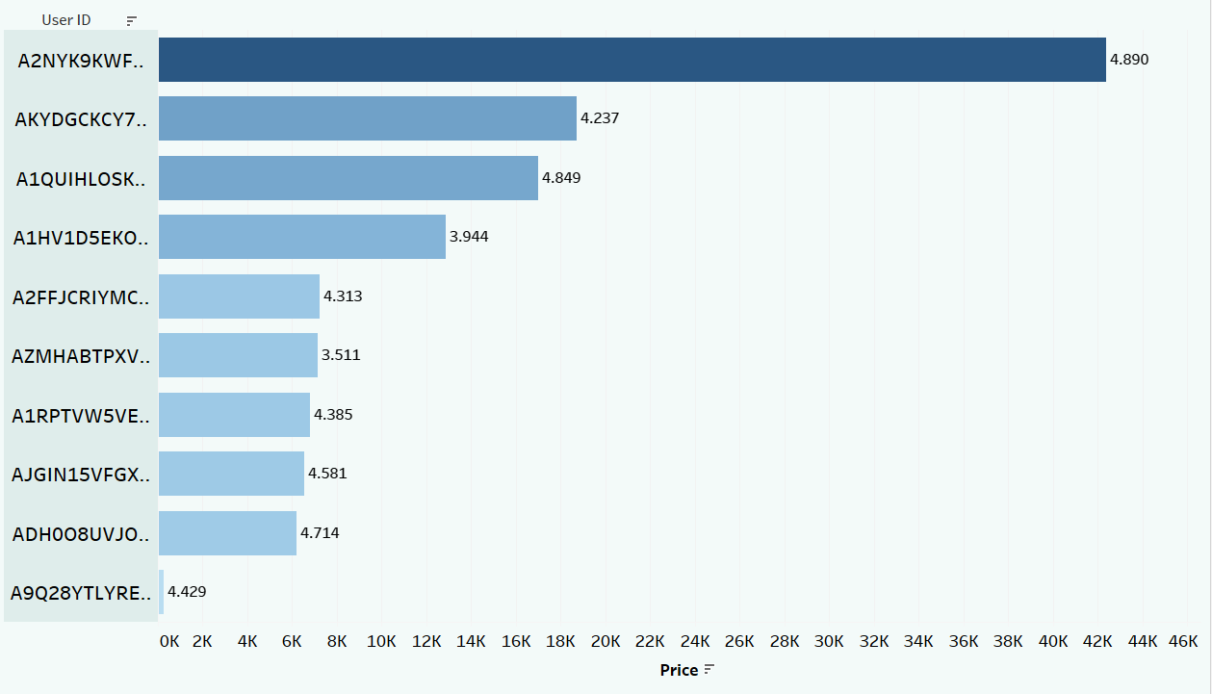
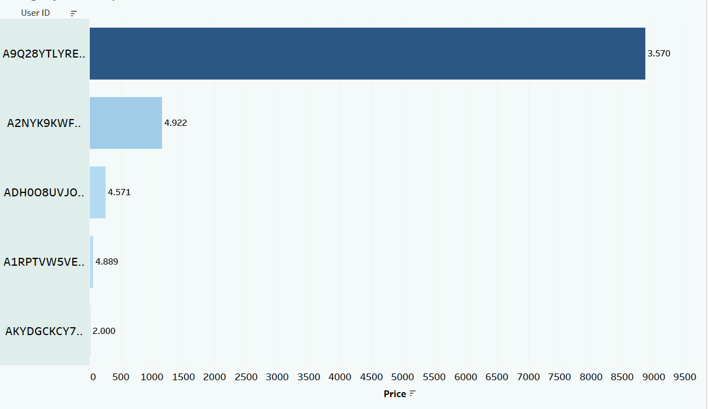
REVENUE WISE TOP CUSTOMERS
Musical Instrument Category
Digital Music Category

Slide 9
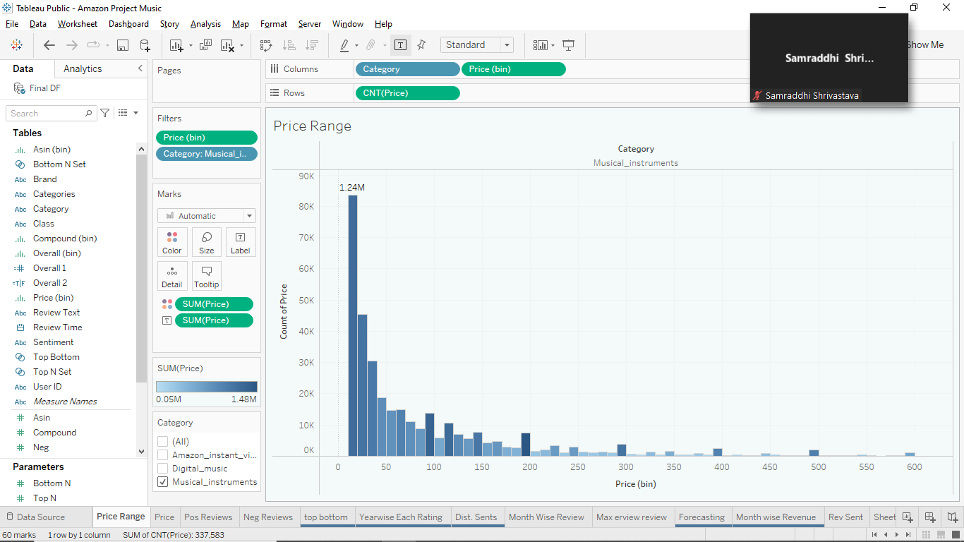
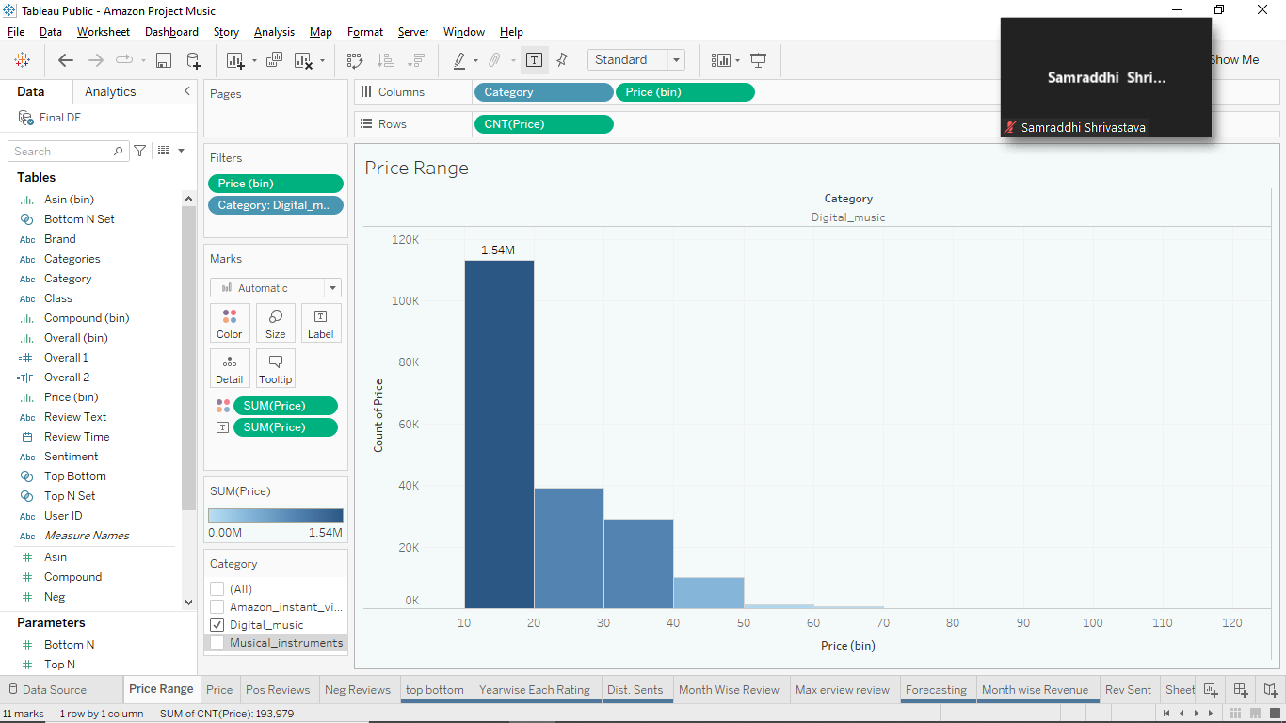
PRICE DISTRIBUTION OF PRODUCTS
Musical Instruments Category
Digital Music Category
For further analysis of data, we will head towards Dashboard

Slide 10
SENTIMENT ANALYSIS
Sentiment Analysis is the most common text classification tool that analyses an incoming message and tells whether the underlying sentiment is positive, negative, or neutral.
To make the data more understandable the reviews of the customers are converted into Sentiments using VADER ( Valence Aware Dictionary for Sentiment Reasoning).
Language Detection
Language Translation

Slide 11
TEXT CLASSIFICATION
Text Classification is the process of categorizing text into organized groups.
Using TFIDF (Term Frequency Inverse Document Frequency) for converting text into numbers.
N-Gram
Logistic Regression Model is used to predict sentiments from review text.

Slide 12
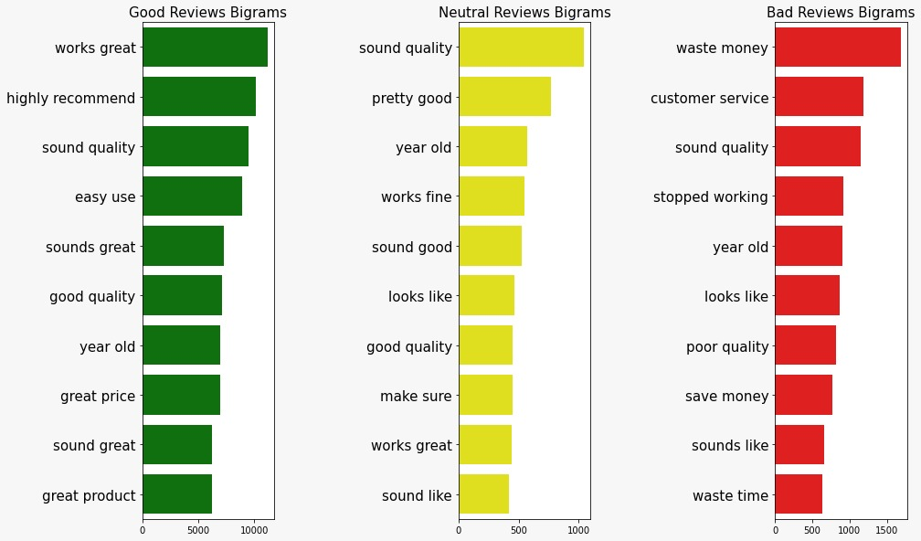
BIGRAM VISUALISATION
Frequently used words in Reviews

Slide 13
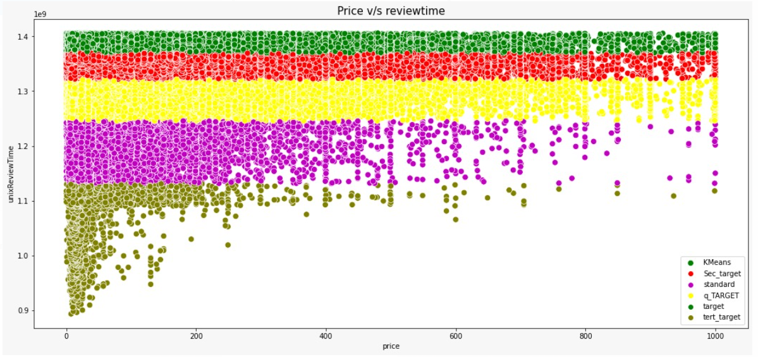
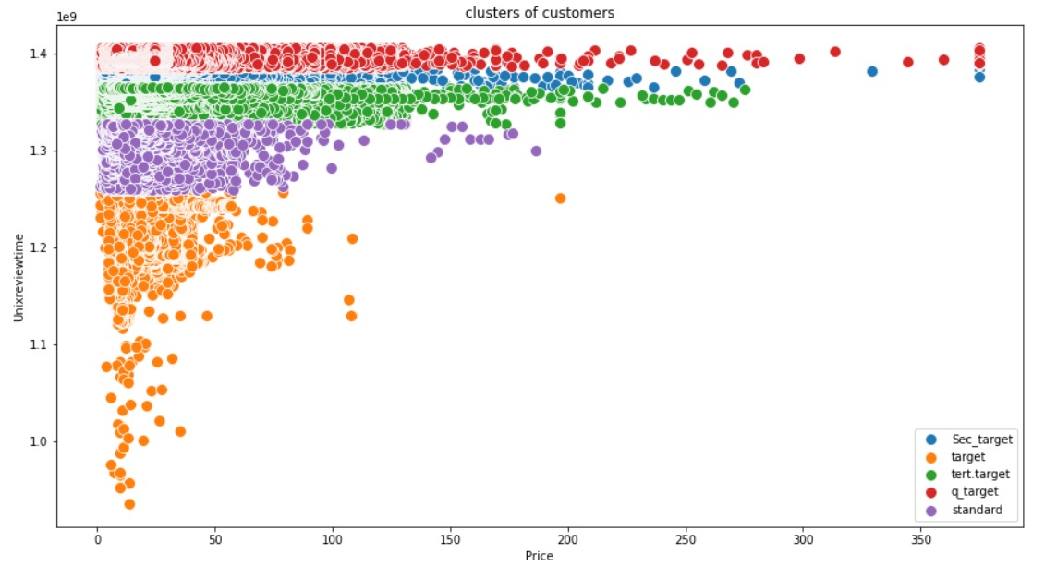
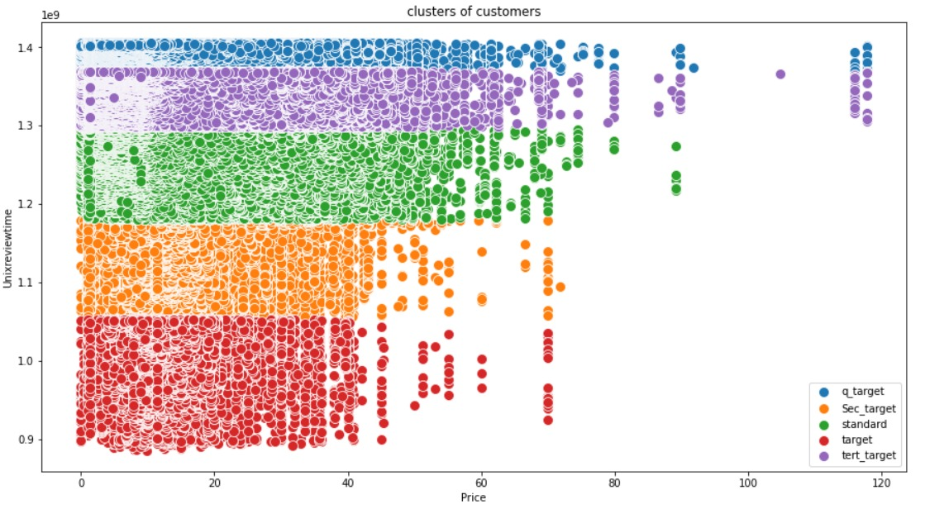
CLUSTERING
Clustering is basically a grouping of data points on the basis of similarity and dissimilarity between them.
FOR MUSICAL INSTRUMENT CATEGORY
FOR AMAZON INSTANT VIDEO CATEGORY
FOR DIGITAL MUSIC CATEGORY

Slide 14
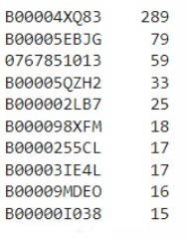
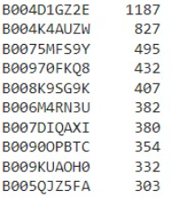
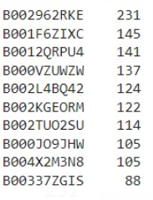

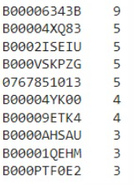
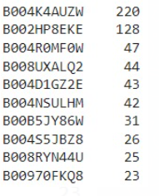
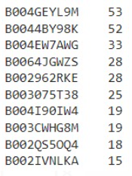
TOP AND BOTTOM PRODUCTS OF VARIOUS CATEGORIES
Musical Instruments
Digital Music
Amazon Instant Video
T
O
P
T
O
P
T
O
P

Slide 15
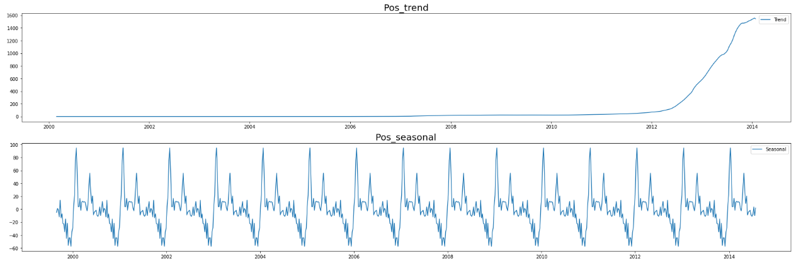
TIME SERIES ANALYSIS
Time Series Analysis is the way of studying the characteristics of the variables with respect to time.
The Overall data have some seasonality and trend.
The data has been converted into Weekly data.
With the help of Time Series Analysis we can forecast various continuous entities which can help us understand the trend better.

Slide 16
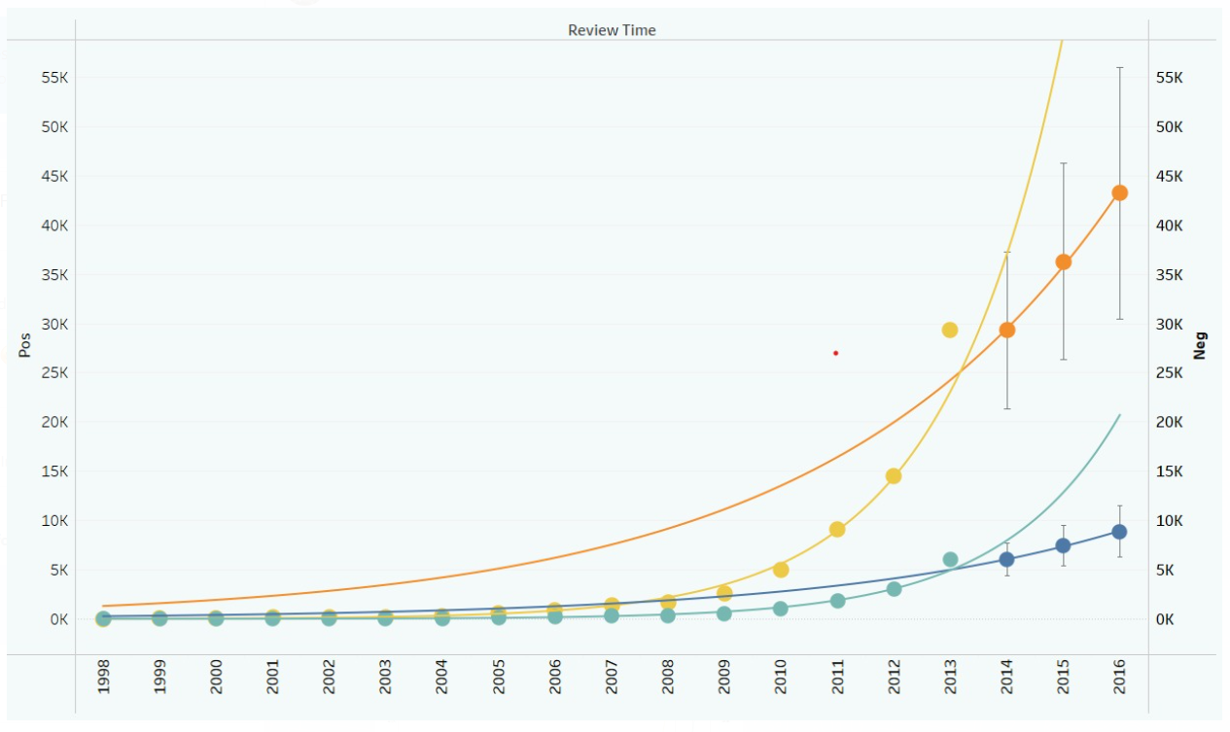
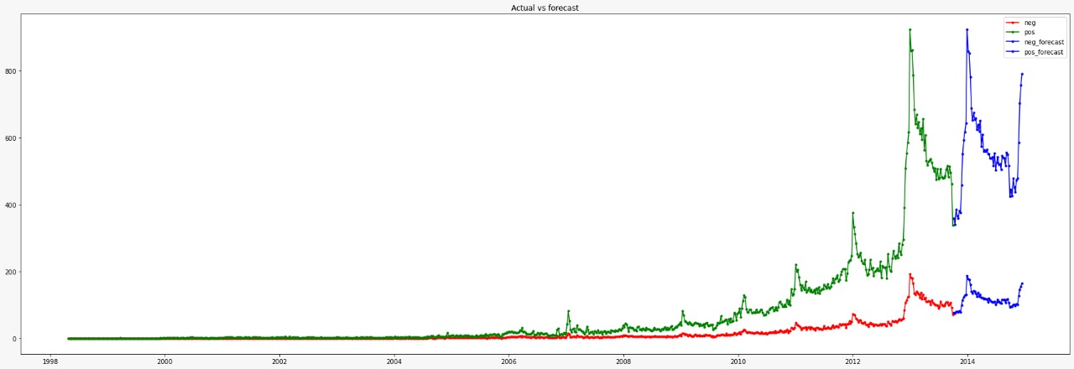
FORECASTING OF POSITIVE AND NEGATIVE SENTIMENTS
FOR MUSICAL INSTRUMENT CATEGORY

Slide 17
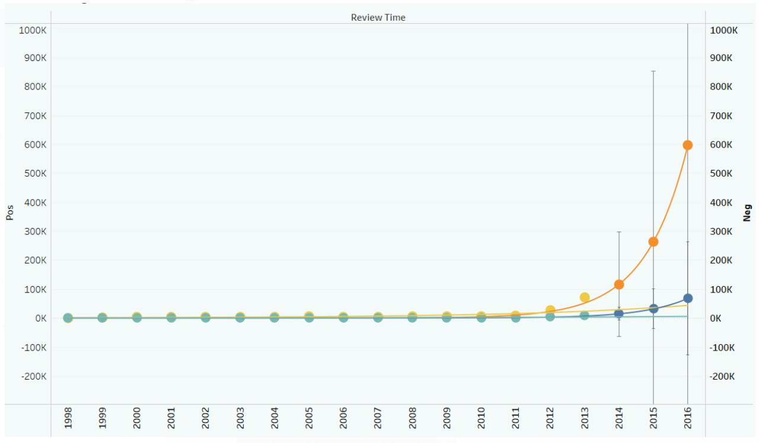
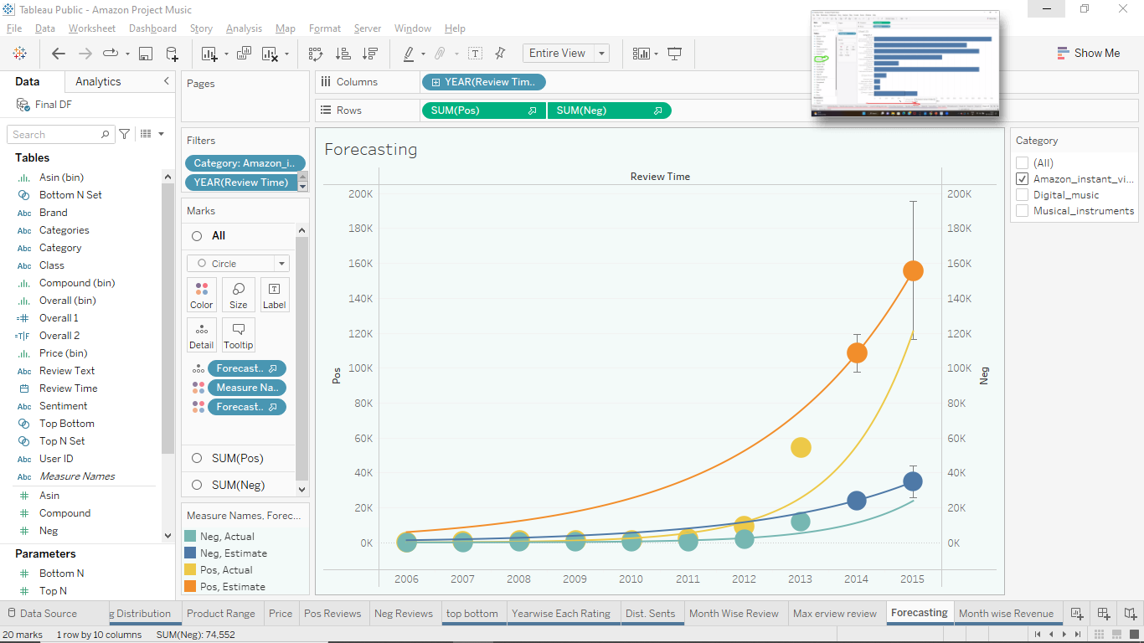
FORECASTING OF POSITIVE AND NEGATIVE SENTIMENTS
FOR DIGITAL MUSIC CATEGORY
FOR AMAZON INSTANT VIDEO CATEGORY

Slide 18
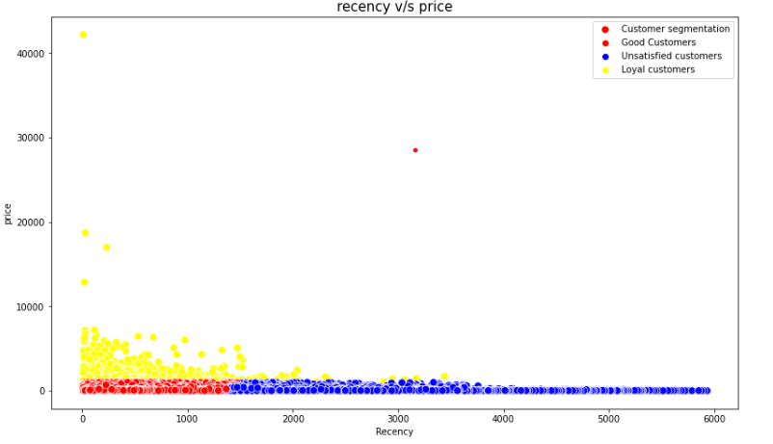
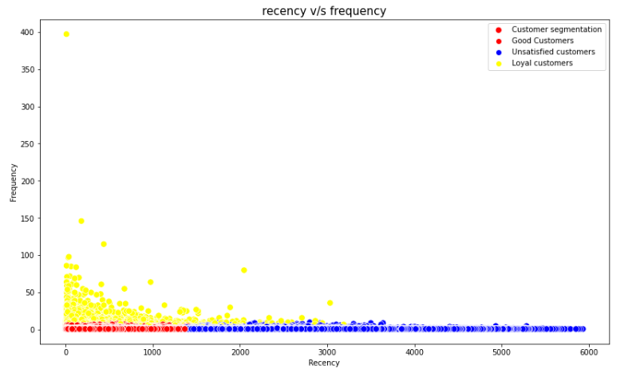
CUSTOMER SEGMENTATION
Customer segmentation is playing an important role in terms of retaining the customers
RFM Model
Recency
Frequency
Monetary value

Slide 19
PRODUCT RECOMMENDATION
Recommendation systems collect customer data and auto-analyze this data to generate customized recommendations for your customers
Amazon Recommendation System
Collaborative filtering(mode-based)
Correlation Matrix
Truncated SVD

Slide 20
Recommended Products for Musical Instruments
PRODUCT 1 – B0002BG2DQ
GATOR NOTE KEYBOARD COVER GKC
PRODUCT 2 – B0002ABOFS
NUMARK PT01 PORTABLE DJ TURNTABLE
0739079883 – ALFRED’S KIDS GUITAR COURSE COMPLETE STARTER PACK
0739079883 – ALFRED’S KIDS GUITAR COURSE COMPLETE STARTER PACK
B00001W0DT – ONE FOR THE KIDS
1417030321 – BROKEBACK MOUNTAIN
B000068IDU – CASIO GSDX DELUX KEYBOARD STAND
B000002LB7 - ELECTRIC
B000068NTU – FOOT LONG MIDI TO MIDI CONNECT CABLE
B00004UFRO – SONY WCS999 WIRELESS CAMCORDER MICROPHONE FOR DCR-DVD101
B000068NVI – HOSA CABLE GTR210 GUITAR INSTRUMENT CABLE FOOT
B00004XQ83 – O BROTHER WHERE ART THOU

Slide 21
SUMMARY TABLE
Title | Musical Instrument | Digital Music Data | Amazon Instant Video
1. Pre-processing | Null Value Dropped | Null Values Imputation | Null Values Imputation
2. Sentiment Analysis | TFIDF, VADER | TFIDF, VADER | TFIDF, VADER
3. Models | Logistic Regression | Logistic Regression | Logistic Regression
4. Evaluation - Accuracy | 86% | 92% | 88%
5. Evaluation - F1 | 84% | 90% | 86%
6. Clustering | Kmeans Clustering | Kmeans Clustering | Kmeans Clustering
7. TSA | SARIMA | SARIMA | SARIMA
8. Forecasted Pos, Neg Sentiment | Sharp upward, mild upward | Sharp upward, mild upward | Sharp upward, mild upward
9. Reviewer Name (Max) | John | Michael | Amazon Customer
10. Top and Bottom Product | B00004XQ83,B00006343B | B004D1GZ2E,B0004K4AUZW | B002962RKE,B004GEYL9M
11. Recommended Product | B00004UFRO | B00000016T | B000HZEHL6

Slide 22
BUSINESS SOLUTIONS
EDA
Count of reviews increasing over the period of time
Revenue is increasing over the period of time
SENTIMENTAL ANALYSIS
Model is able to detect and translate all the languages to English
Model is able to Automate Sentiment Predictions
CLUSTERING
Model is able to segregate top and bottom products
Model is able to create segments based on customer perceptions
PRODUCT RECOMMENDATION
Model is able to recommend related products based on customer purchase
Model is able to forecast future trend of the sentiments

Slide 23
THANK YOU

